Slide 1

The Effects of gasoline prices on air quality
Project #3
Thomas Martin
Liz Lautenslager
Bonnie Bailey

Slide 2

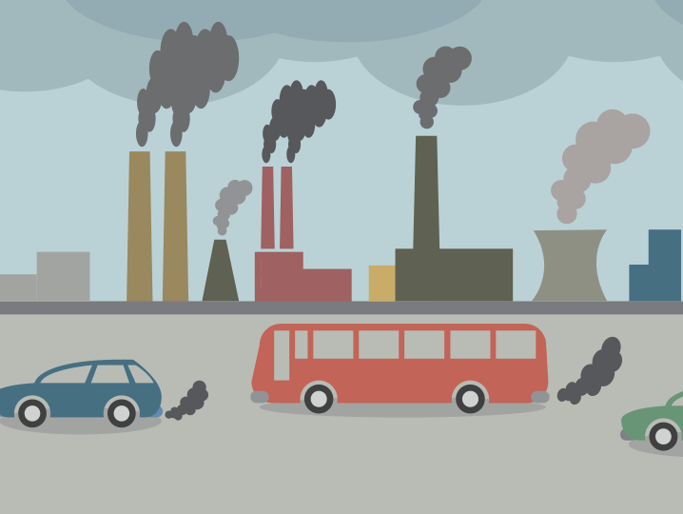
Gas $$$ air quality
Throughout the first half of the pandemic, there was a sharp decline in the price of gas.
A 10% decrease in gas prices is associated with about a 3% increase in driving. This also correlates to higher amounts of greenhouse gas emissions and air pollution.
The inverse is true as well. We wanted to find data on the higher gas prices we have been experiencing and their effect on air quality. As the prices have increased, the amount of driving has decreased giving us slightly better air quality.
There would have been a substantial amount of data if we based it on the entire country. We found data specific to the cities in New York state so our project is specific to that region between the years of 2000-2015.
https://cityobservatory.org/cheaper-gas-bad-for-climate-and-safety/

Slide 3
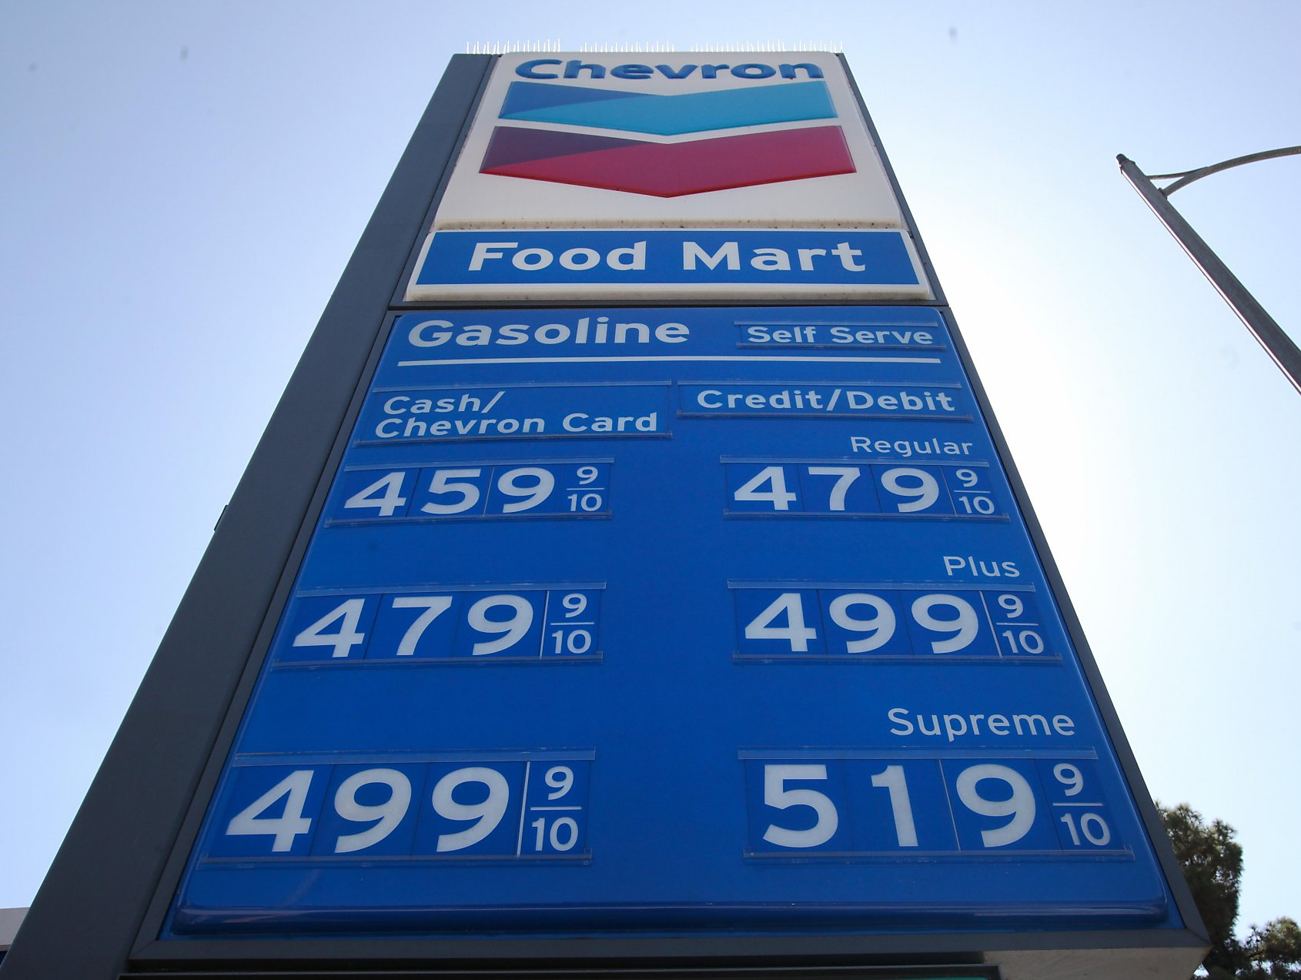
Coding approach
Divided the coding up into parts
Began by searching for our data sources- CSV files
Cleaned the data and combined the CSV files- creating and eliminating all unnecessary columns and rows.
Created an SQL database
Created a scatter plot comparing the # of gallons of gas sold in New York state over the years 2000-2015.
Created a line graph comparing the average price of gas per gallon in New York state to the # of Unhealthy Environment Days over the years 2000-2015.
Formatted an HTML site using CSS to stylize and buttons to link to our visualizations

Slide 4
SQL Database

Slide 5
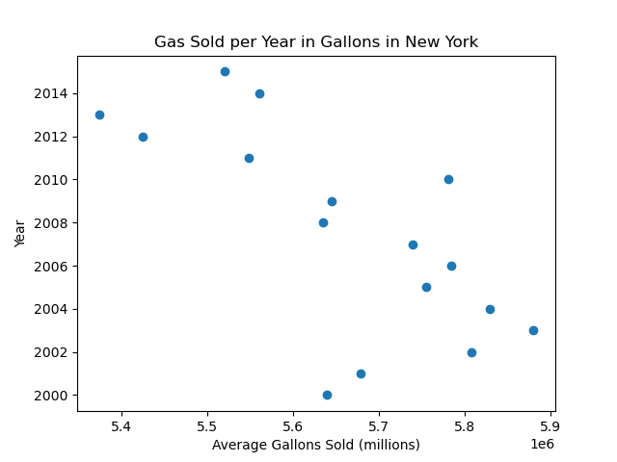

Slide 6
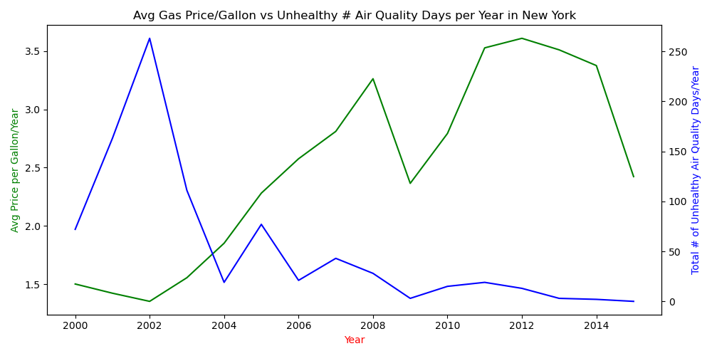

Slide 7
HTML
Created a basic HTML web page using CSS
Added user interface with 2 links that take the user to additional views where the scatter plot and line graphs are displayed.
The data can be modified at any time.

Slide 8
Conclusions & challenges
Conclusions:
The visualizations show the correlation between gas prices and air quality. As the price per gallon of gas went up, the number of unhealthy air quality days went down.
The intention for this HTML site is that the data COULD be expanded to the entire country and users could select their city and state and see the air quality rating for any given time and how it correlated to actual gas prices.
Challenges:
- Limited knowledge of the topics, scheduling challenges, extensive amount of data that needed to be narrowed to one region.

